Slide 1
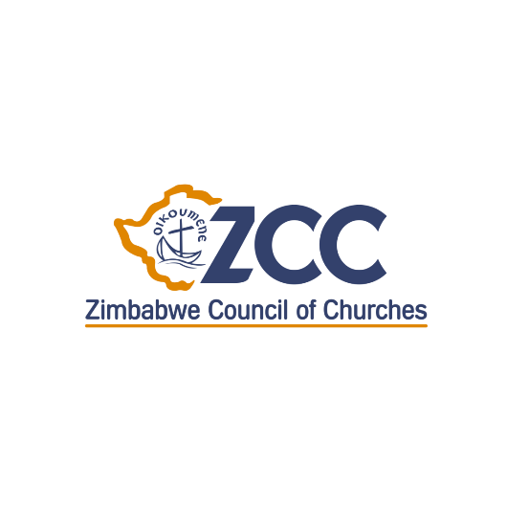
The Potential of Churches as Agents for Justice and Peace in Africa
– Some Observations –
26th of October 2020

Slide 2
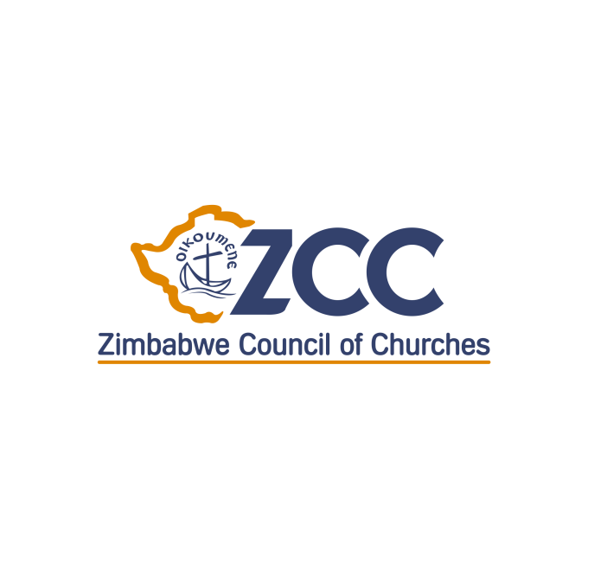
Table of content
Context of the churches’ engagement
Some recent efforts
Challenges
Opportunities
Concluding remarks

Slide 3
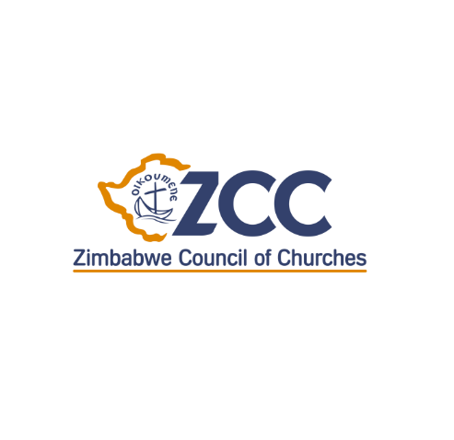
Context
Zimbabwe and the rest of Africa are going through a new wave of unrest due to the governments’ failure to meet the social, economic and political justice expectations of citizens
There are too numerous examples of countries in the Sub Saharan region where election results are disputed, where the hand of the military is too involved in politics, where corrupt use of national resources and inconsistent economic policy, violent resolution of disputes are the order of the day.
Zimbabwe is a typical example of an African country failing to fully transition from a colonial to a modern African democracy. It is currently struggling with severe humanitarian crises, mistrust and lack of confidence due to unresolved hurts of the past, exclusive failing economy characterized by rampart corruption, the failure to fully implement the constitution, and continued international isolation.

Slide 4
Varying orientations of church responses
Religious actors have had different interventions to respond to these multi-layered crises
a. Active endorsement or legitimation of the status quo
— “governments are put in place by God”
— beneficiaries of the system
— fear—blackmailed
b. Resignation and indifference
— “Separation of realms”
— “we must prepare people for heaven”
— “it is impossible to change anything from outside”
c. Critical engagement—shaped by
— injunctions from scripture and theology
— Historical precedence
— commitment to the constitution

Slide 5
Advantage of Churches’ engagement
Churches have advantage in engagement at the levels of local community, organized society and policy or political actors
a. Local or grassroot communities
— awakening a critical sense of double citizenship using familiar ideas, structures and rituals or practices
—safe space for local communities to deal with ‘sensitive issues’
b. Organized society
— trusted as a convenor and a safe space for other CSOs
c. Political level
— Political actors find it difficult to ignore what the church is saying as churches are trusted by citizens—duty bearers forced to act

Slide 6
Disadvantage of Churches’ engagement
Churches have advantage in engagement at the levels of local community, organized society and policy or political actors
a. Local or grassroot communities
— Church ideas, structures and rituals or practices can be easily alienating
b. Organized society
— competition for resources can make cooperation compromised
— association of the church with secular CSOs can weaken the ‘neutrality’ of the church
c. Political level
— Political actors can set up competing church groupings and create divisions
— Political actors can tarnish the reputation of individual church leaders

Slide 7
Way forward
Churches and religion will continue to play a central role towards finding sustainable peace, justice and development in Africa and in Zimbabwe. To increase their effectiveness, churches will need:
Strong leadership, organizing and coordination capacity at congregational, community, regional and national levels
Capacity for regional and international reach
Flexible funding model

